Slide 1



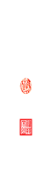






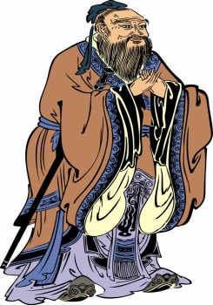
Meta-analysis of Genome-wide Association Provides New Insights into Tomato Favor
Jiantao ZHAO
赵建涛
Mathilde CAUSSE
Christopher SAUVAGE

Slide 2

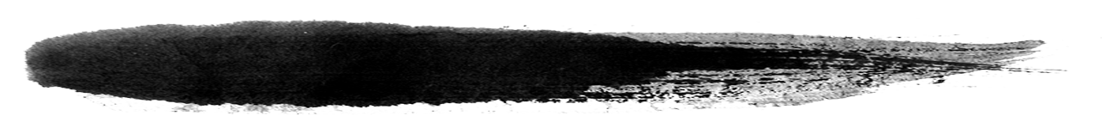
Context
1
Background
Materials
Methods
Challenges
Expectations
Results
2
3
4
5
6

Slide 3
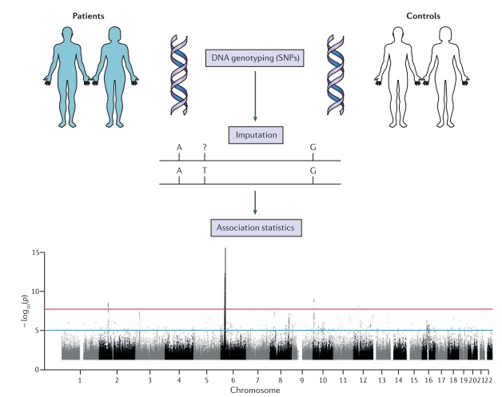
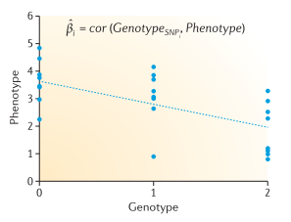
Background
Materials
Methods
Results
Challenges
Expectations
What’s and Why GWAS?
Genome-Wide Association Studies
Pasaniuc and Price 2018 Nature Review Genetics
Sud et al. 2017 Nature Review Genetics

Slide 4
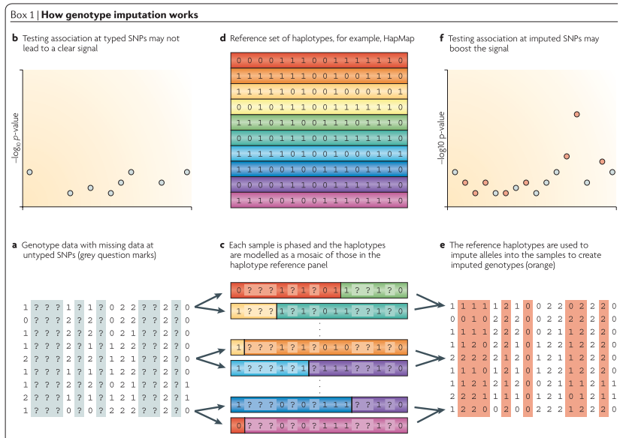
Background
Materials
Methods
Results
Challenges
Expectations
Marchini and Howie 2010 Nature Review Genetics

Slide 5
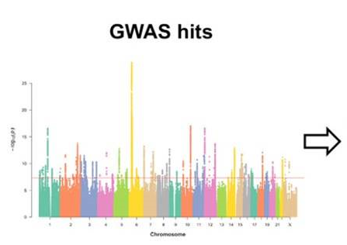
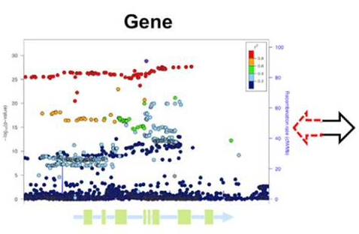
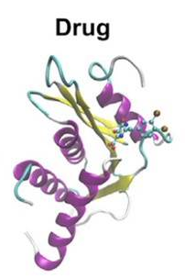
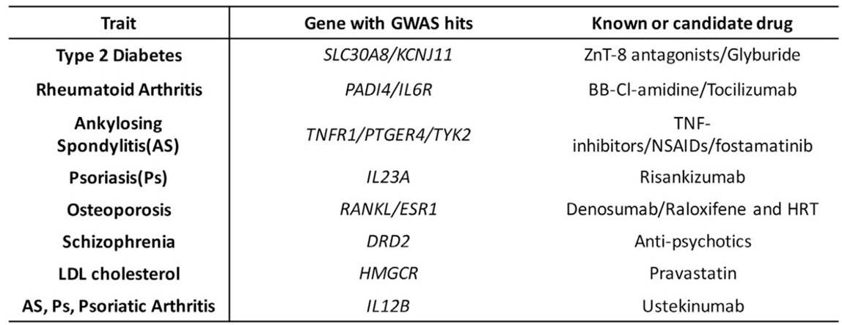

Background
Materials
Methods
Results
Challenges
Expectations

Slide 6
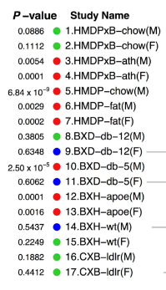
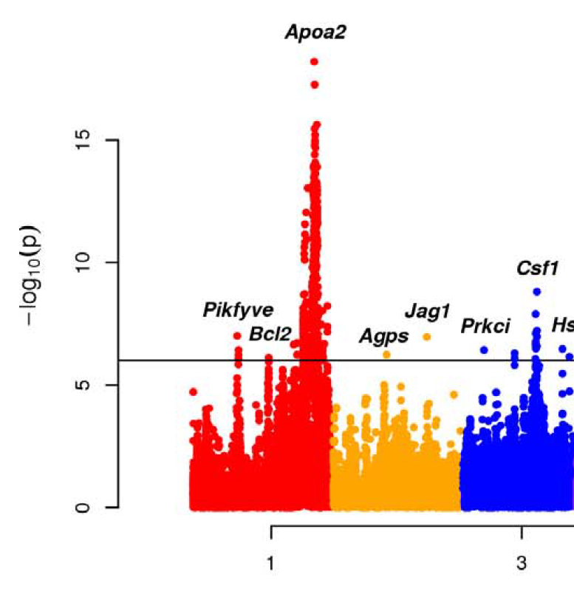

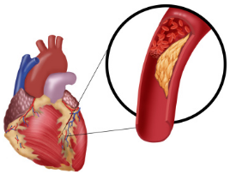
Background
Materials
Methods
Results
Challenges
Expectations
Limitations
How to define the differences?
高胆固醇血症/Hypercholesterolemia/Hypercholestérolémie/Apoa2

Slide 7
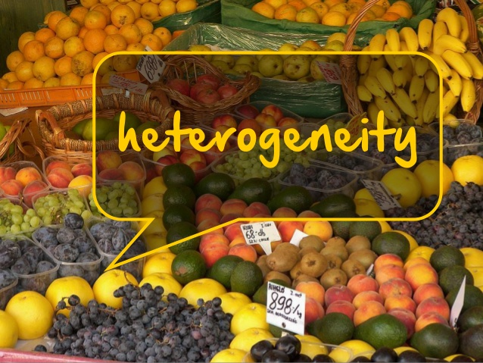
Background
Materials
Methods
Results
Challenges
Expectations
Heterogeneity
Heterogeneity in meta-analysis of GWAS: The variation in the genetic effects observed among combined studies (Panagiotou and Ioannidis 2013).
Environmental factors
Population structure
Genetic factors
Statistical factors
Measurements
Linkage disequilibrium
Genotyping methods
Imputation accuracies
G x E interactions

Slide 8
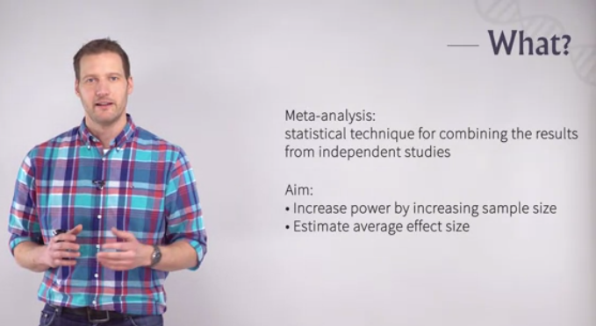

Background
Materials
Methods
Results
Challenges
Expectations
Meta-analysis
Meta-analysis
What?

Slide 9
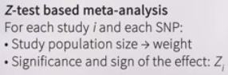

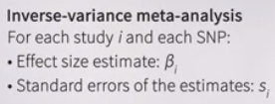
Background
Materials
Methods
Results
Challenges
Expectations
Models
--- for meta-analysis
Z-test
Fixed-effect model
Inverse-variance
Meta-analysis
Random-effect model
Han Eskin
Evangelou and Ioannidis 2013 Nature Reviews Genetics

Slide 10
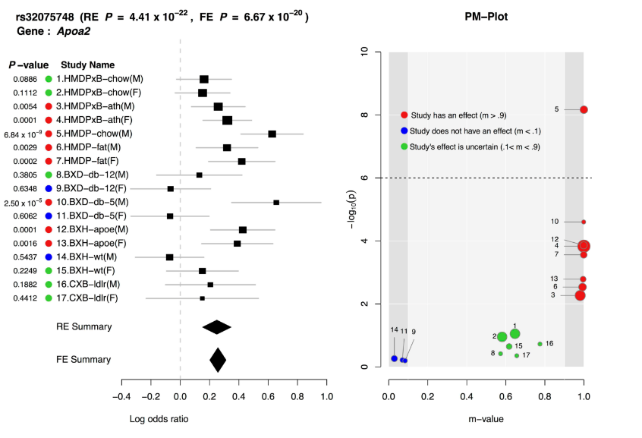
Background
Materials
Methods
Results
Challenges
Expectations
Fixed vs Random
Han and Eskin, 2012 PLoS Genetics

Slide 11
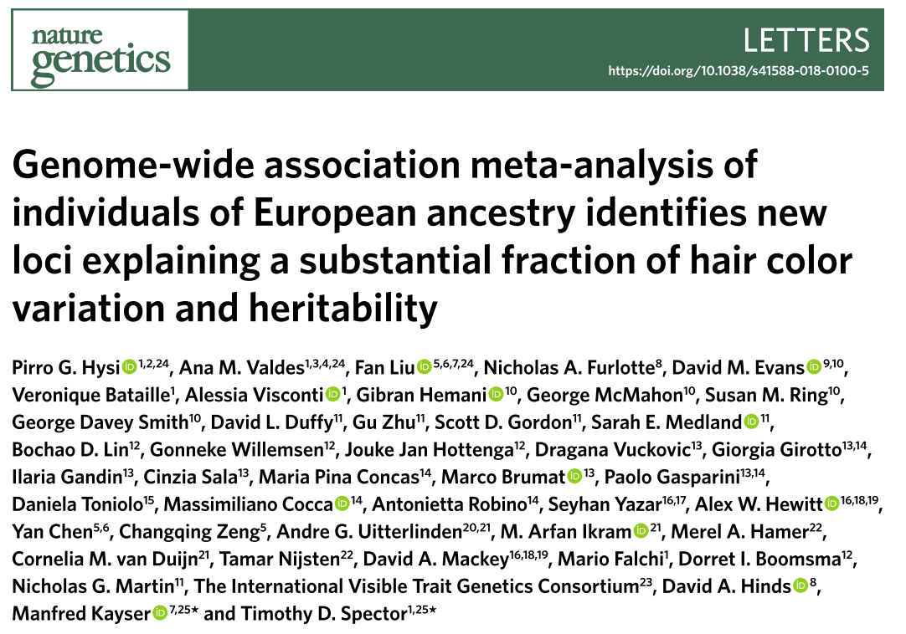
Background
Materials
Methods
Results
Challenges
Expectations
Example
GWAS

Slide 12
Background
Materials
Methods
Results
Challenges
Expectations
Landmarks in tomato
1st Tomato genome
Wild Tomato genome
SOLCAP
100 Tomato genome
50 Tomato genome +
CBSG
360 Tomato genome
Reference panel
2012
2013
2014
2015
2016
2017
2018
Metabolites
Panel S
Flavor
Panel T
Flavor
Panel B
Nature 2012; Nature Genetics 2014; Plant Physiology 2014;
Plant Journal 2014; New Phytologist 2017; Science 2018; Cell 2018

Slide 13
Background
Materials
Methods
Results
Challenges
Expectations
Main questions
What can we gain from genotype imputation in tomato?
Will imputation-driven GWASs have a better performance?
What is the benefit of conducting a meta-analysis of GWASs in tomato?

Slide 14
Background
Materials
Methods
Results
Challenges
Expectations
Table 1. Summaries of different GWAS panels used in the meta-analysis
GWAS panel | Sauvage et al., 2014 | Bauchet et al., 2017 | Tieman et al., 2017
Panel code | S | B | T
Population size | 163 | 300 | 402
Phenotype replications | 2007 and 2008 | 2011 and 2012 | Florida and Israel
Genotype method | SOLCAP arrays | SOLCAP and CBSG arrays | Whole-genome sequencing
Genotyped SNPs | 5,995 | 9,013 | 2,014,488
MAF | 0.037 <MAF<0.45 | MAF>0.01 | MAF>0.05
Population structure | K=2 | K=6 | K=5
GWAS model | MLMM | MLMM | EMMAX
Sugars and acids 4 | Citrate | Citrate | Citrate
 | Fructose | Fructose | Fructose
 | Malate | Malate | Malate
Amino acids 10 | Asparagine | Asparagine
 | Aspartate | Aspartic acid
 | Glutamine | Glutamine
 | … | …
Volatiles 17 |  | (E)-2-heptenal | (E)-2-heptenal
 |  | (E)-2-hexenal | (E)-2-hexenal
 |  | (Z)-3-hexenal | (Z)-3-hexenal
 |  | … | …

Slide 15
Background
Materials
Methods
Results
Challenges
Expectations
Global strategy
Genotype
Phenotype
Geno S
Geno B
Geno T
Pheno T
Pheno B
Pheno S
Sugars and organic acids
Sugars and organic acids
Sugars and organic acids
Genotype imputation
Volatiles
Volatiles
NA
Quality control
NA
Amino acids
Amino acids
Geno S’
Geno B’
Geno T’
GWAS S
GWAS T
GWAS B
Meta-analyses

Slide 16

Background
Materials
Methods
Results
Challenges
Expectations
Meta-analysis summary
Meta-analysis model:
Fixed-effect model & Random-effect model
A total of 788 tomato accessions and 2,316,117 SNPs from three GWAS panels were used for the final meta-analysis for 25 flavor-related traits.
Meta-analysis identified a total of 305 significant loci associated with sugars (fructose and glucose), organic acids (malate and citrate), amino acids and flavor-related volatiles, 211 of which are novel.

Slide 17
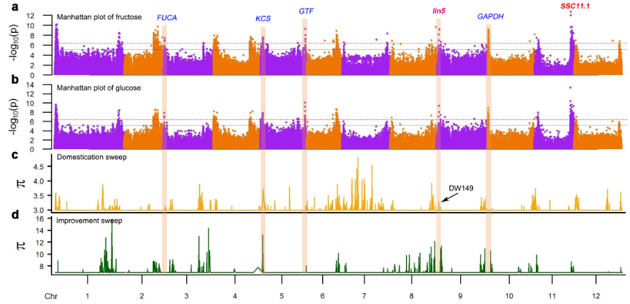
Why modern tomatoes are not sweet?
Background
Materials
Methods
Results
Challenges
Expectations

Slide 18
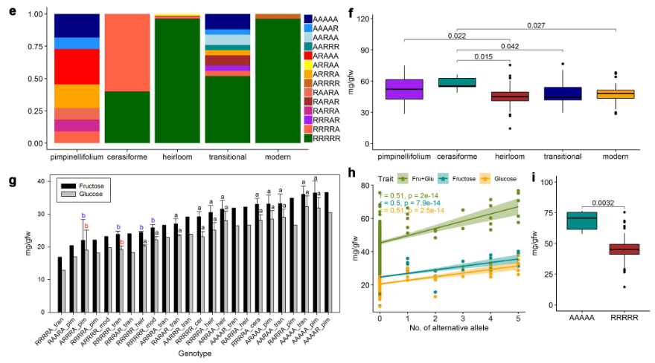
How to make modern tomatoes sweeter?
Background
Materials
Methods
Results
Challenges
Expectations

Slide 19
Background
Materials
Methods
Results
Challenges
Expectations
Answers!!!
YES!!!
Imputation works and can greatly increase the density of SNPs in high quality!
YES!
Imputation-driven GWASs do have a better performance, but limited!
YES!
Meta-analysis of GWASs can greatly promote our the identification of novel candidate genes

Slide 20
Background
Materials
Methods
Results
Challenges
Expectations
GWAS will still be powerful and popular.
Meta-analysis of GWAS will witness increasing attention and will be the next new era.
Integrating Meta-analysis into genomic selection will be more promising in real tomato breeding practices.
This will be the next story!

Slide 21

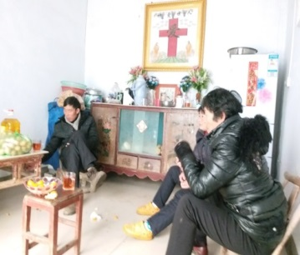

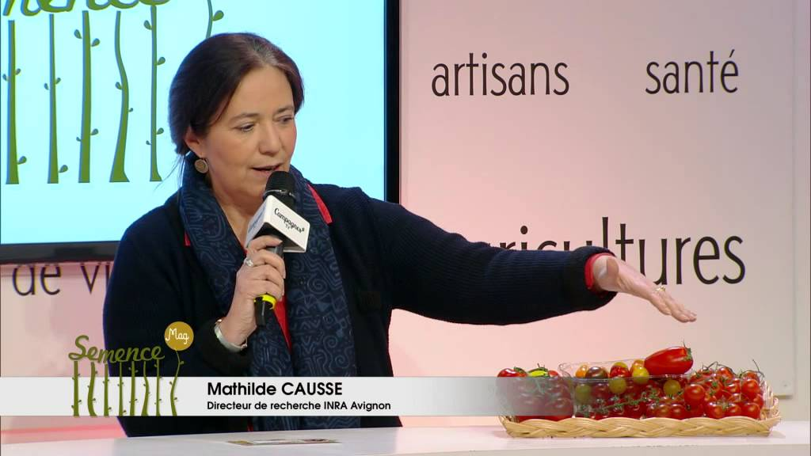
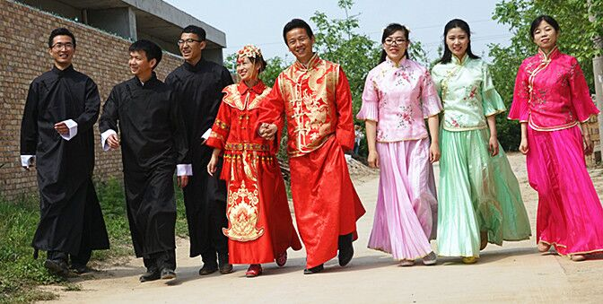


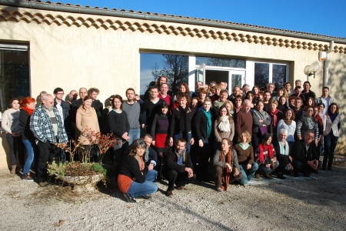
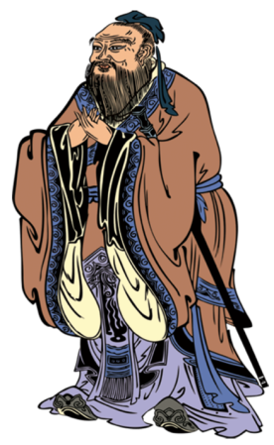



Acknowledgements

Slide 22

Background
Materials
Methods
Results
Challenges
Expectations
Meta-analyses
Increase statistical power
Reduce false-negative associations
Increased precision of estimated variance
Account for missing heritability
Facilitate detection of rare variants
Zeggini and Ioannidis 2009 Nat Genet; Evagelou and Ioannidis 2013 Nat Genet Rev; Sud et al. 2017 Nat Rev Cancer; Wijmenga et al. 2018 Nat Genet

Slide 23
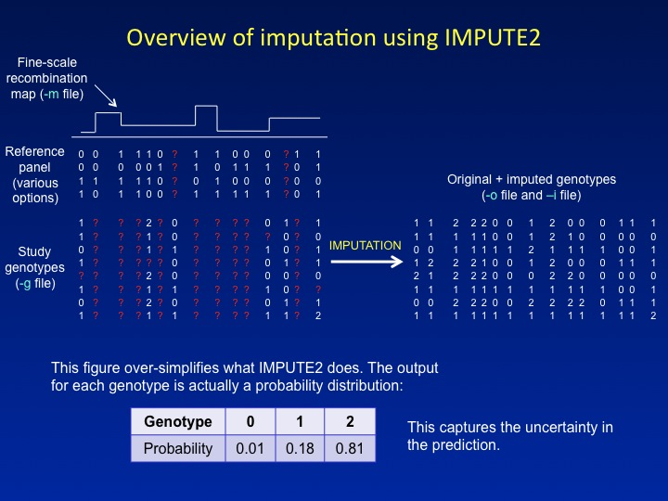
Background
Materials
Methods
Results
Challenges
Expectations
Imputation
Howie et al.
2009 PLoS Genetics;
2012 Nature Genetics

Slide 24
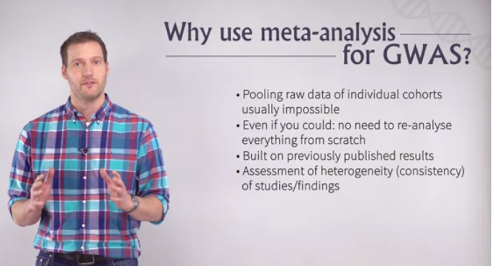
Background
Materials
Methods
Results
Challenges
Expectations
Meta-analysis

Slide 25
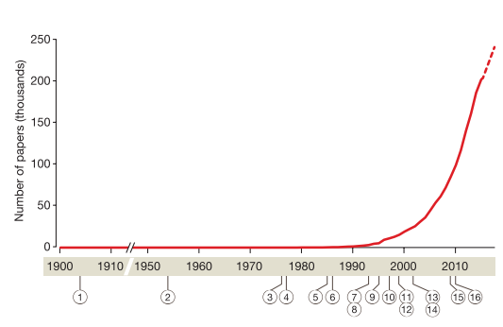
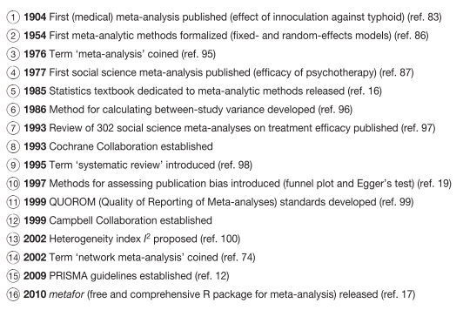
Background
Materials
Methods
Results
Challenges
Expectations
Landmarks
Gurevitch et al. 2018 Nature

Slide 26
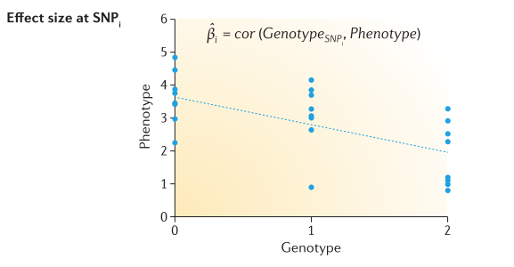
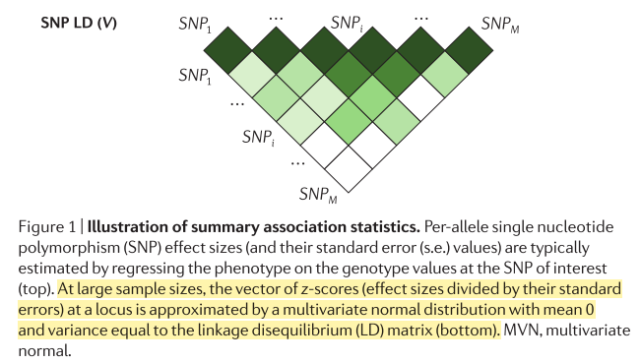
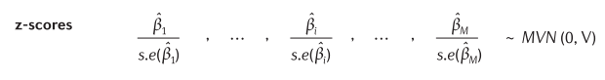
Background
Materials
Methods
Results
Challenges
Expectations
Summary association statistics
p=2*(1-pnorm(abs(z)))
Pasaniuc and Price 2017 Nat Rev Genet

Slide 27
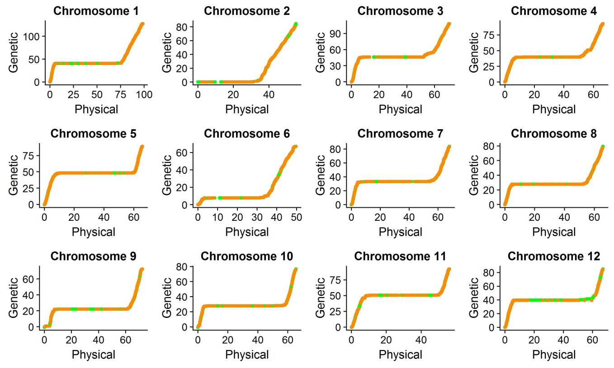
Background
Materials
Methods
Results
Challenges
Expectations
Recombination map
EXPIM 2012
Inferred
Figure 1 Relationship between genetic (cM) and physical positions (Mbp) within each chromosome. Genetic positions of SNPs of the EXPIM 2012 population were indicated in orange and the inferred genetic positions for SNPs in the reference panel were indicated in green.

Slide 28
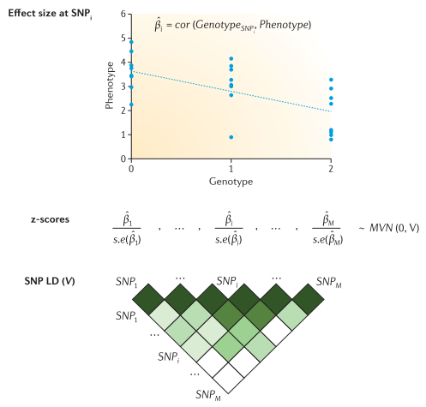
Background
Materials
Methods
Results
Challenges
Expectations
Pasaniuc and Price, 2018 Nat Rev Genet

Slide 29
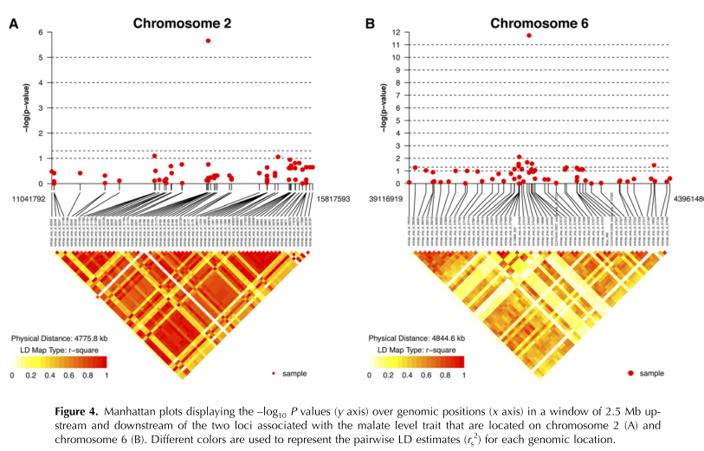
Background
Materials
Methods
Results
Challenges
Expectations
Linkage disequilibrium
: The non-random association of alleles of different linked polymorphisms in a population.
Sauvage et al. 2014
Plant Physiology

Slide 30
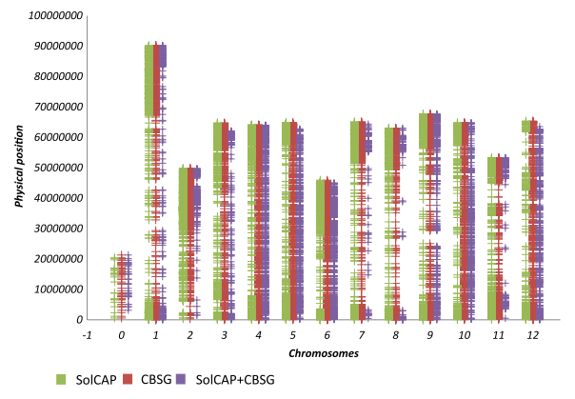
Background
Materials
Methods
Results
Challenges
Expectations
Limitations of SNP Arrays
Sauvage et al. 2014 Plant Physiol;
Bauchet et al. 2017 New Phytol

Slide 31
Background
Materials
Methods
Results
Challenges
Expectations
Imputation greatly increased SNP density
Reference
Imputed
Genotyped
After final quality control, the number of SNPs increased from 5984 to 209,152 (35.55-folds) for panel S.

Slide 32
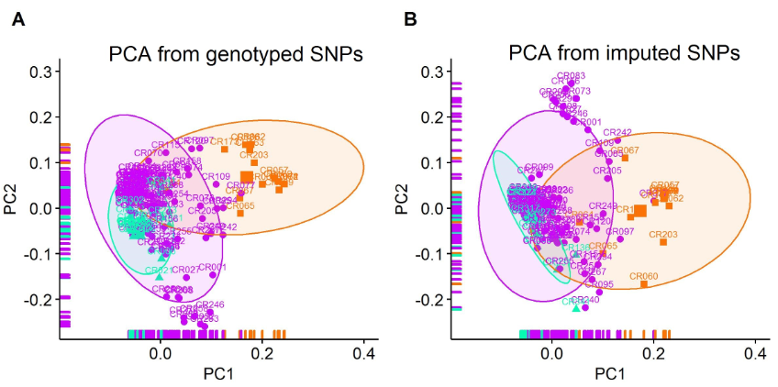
Background
Materials
Methods
Results
Challenges
Expectations
Principal component analysis
Principal component analysis (PCA) comparison before and after genotype imputation for panel S. (A) PCA of genotyped SNPs. (B) PCA of imputed SNPs (r² ≤ 0.2).

Slide 33
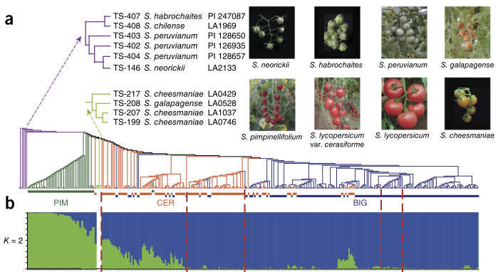
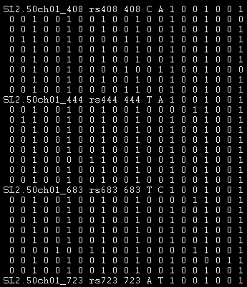
Background
Materials
Methods
Results
Challenges
Expectations
Reference
360 tomato accessions
221 tomato accessions
Lin et al. 2014 Nat Genet

Slide 34
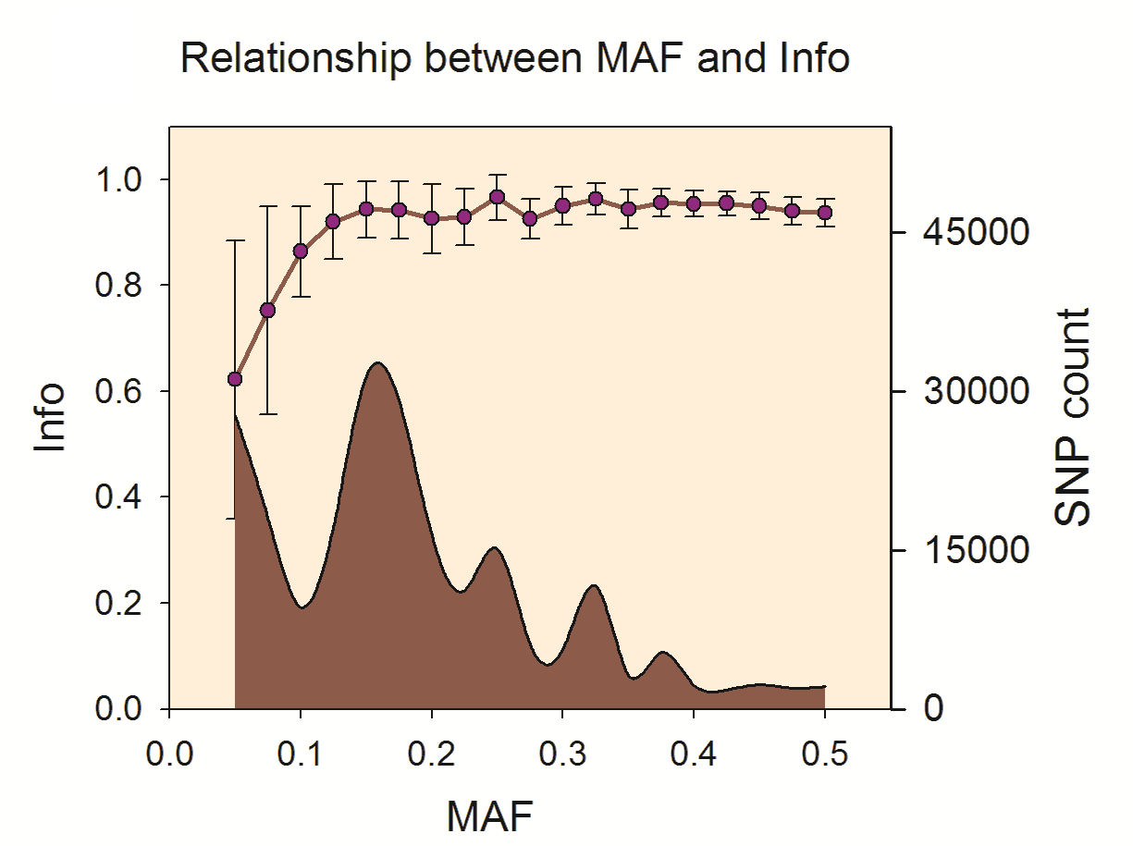
Background
Materials
Methods
Results
Challenges
Expectations
Imputation quality threshold
Before imputation quality (Info) filtering
After imputation quality (Info) filtering

Slide 35
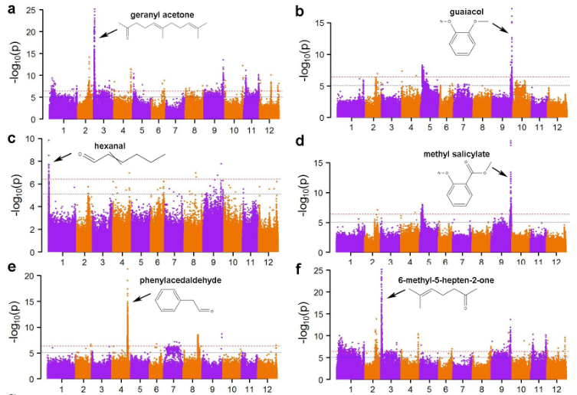
How to breed tomatoes with stronger flavor
Background
Materials
Methods
Results
Challenges
Expectations

Slide 36
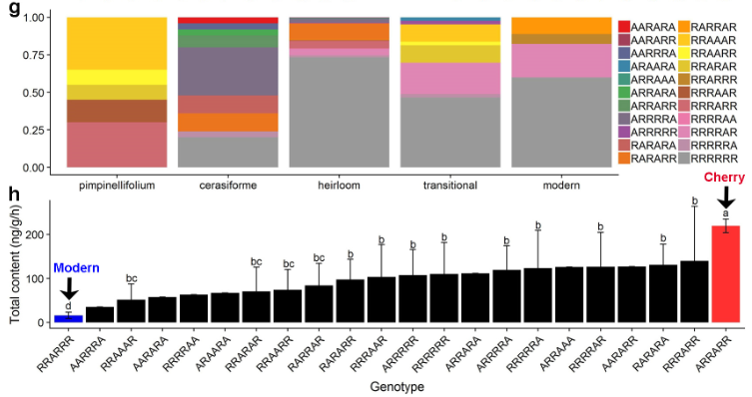
How to breed tomatoes with stronger flavor
Background
Materials
Methods
Results
Challenges
Expectations

Slide 37
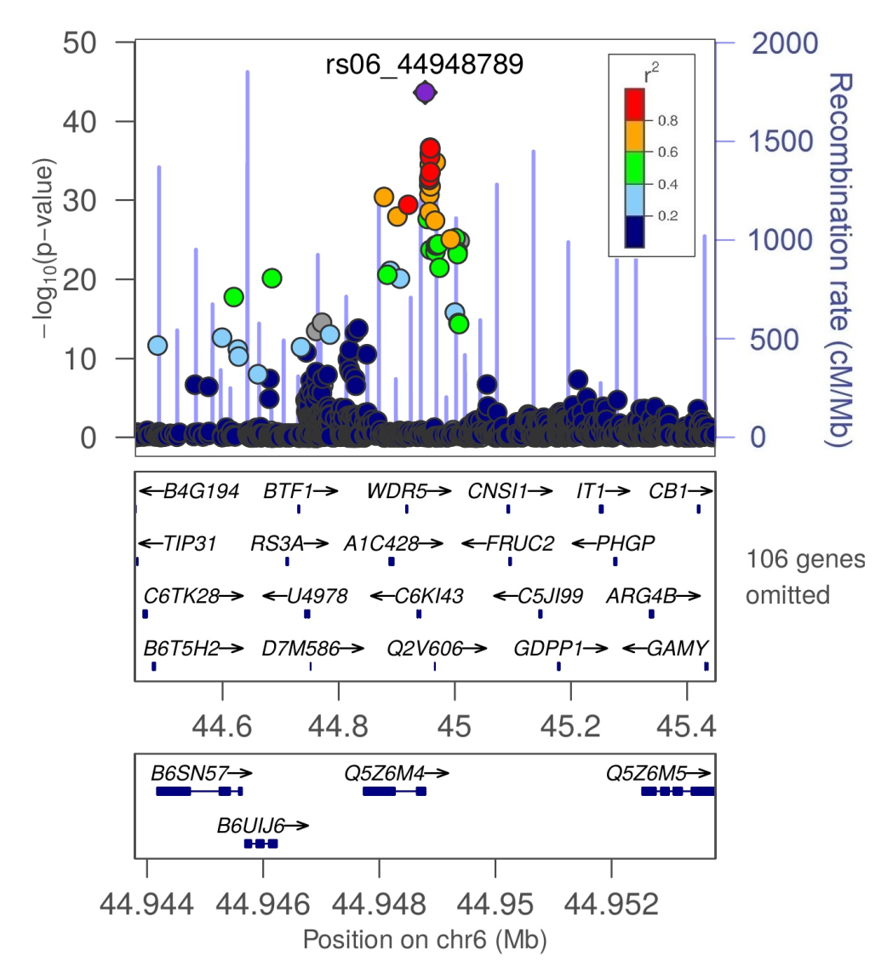
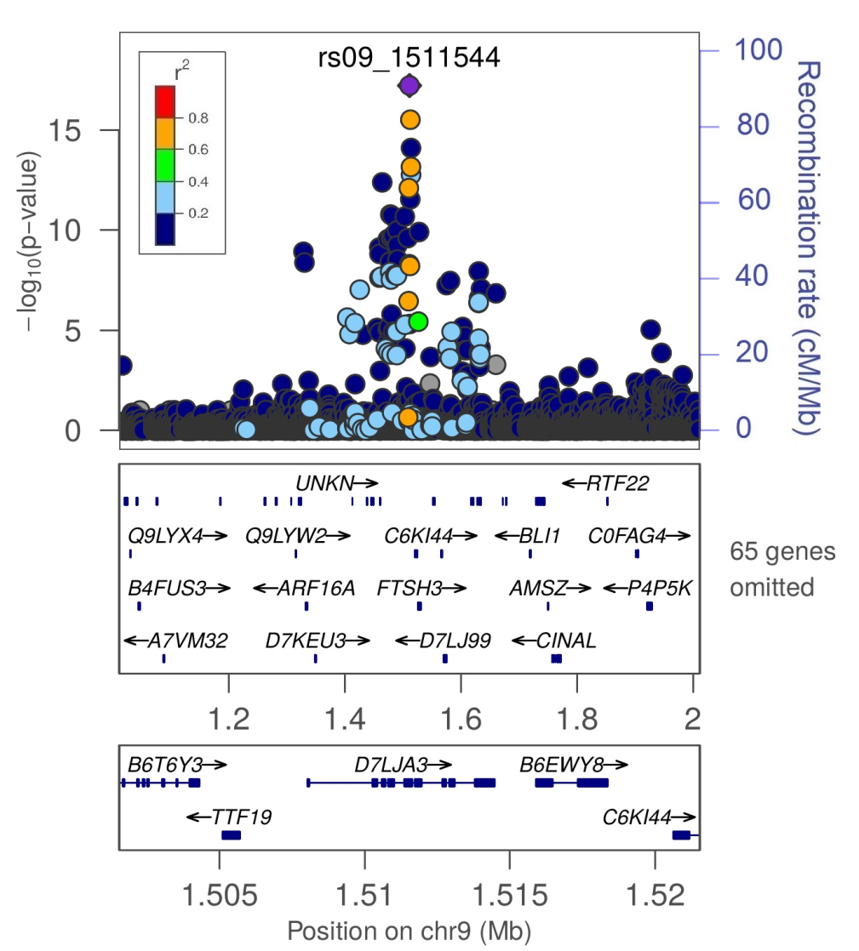
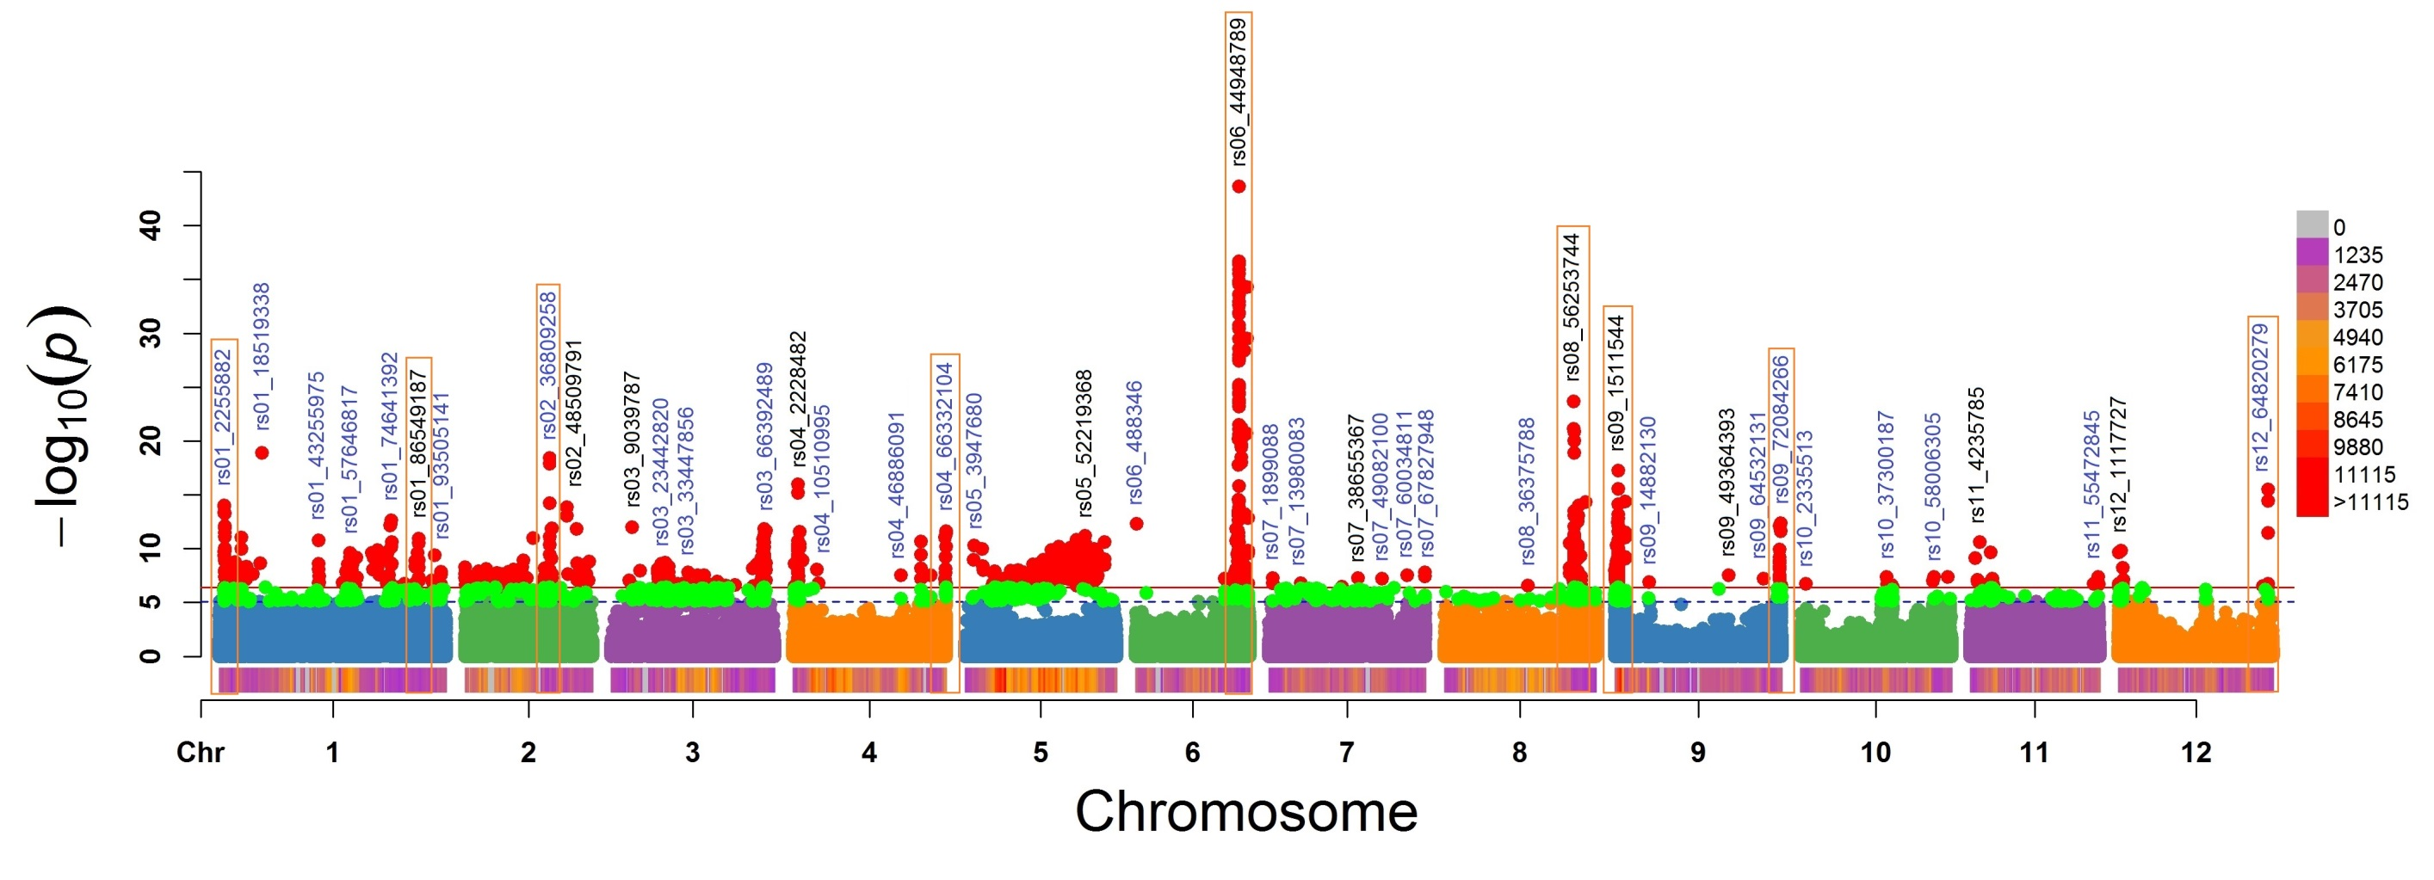
Background
Materials
Methods
Results
Challenges
Expectations
Malate
Al-activated malate transporter 9
Glycosyltransferase

Slide 38

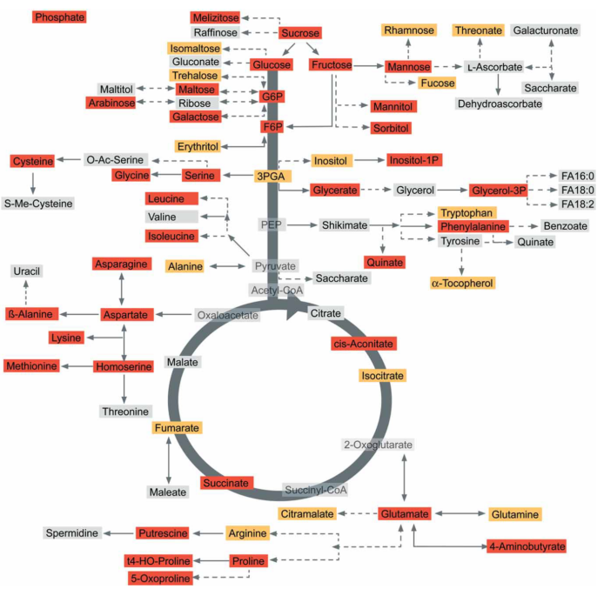
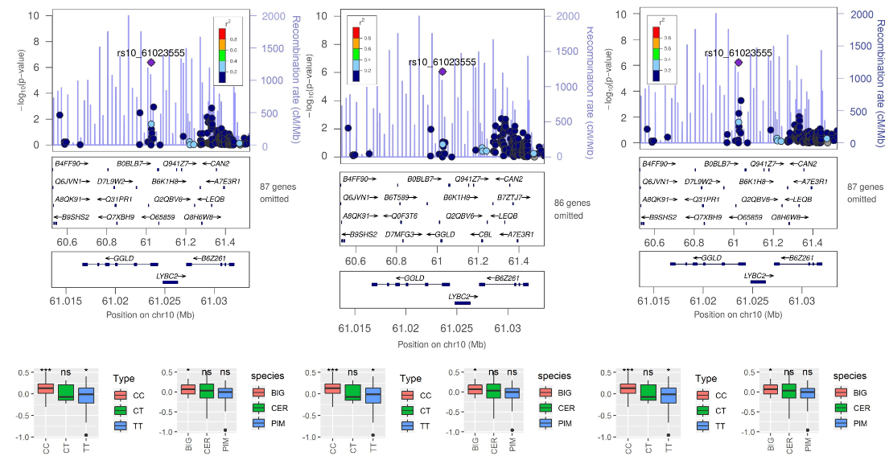
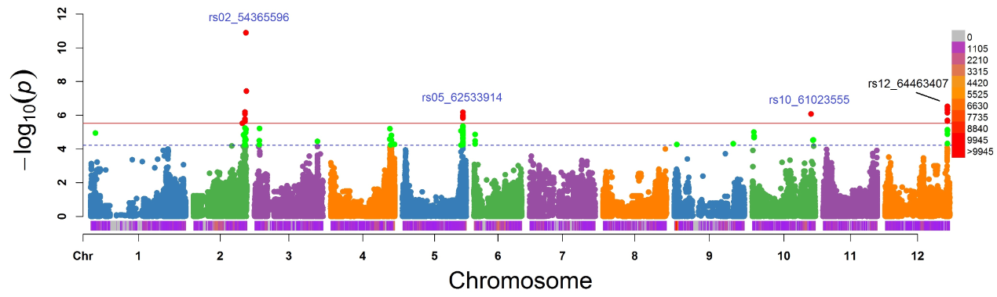
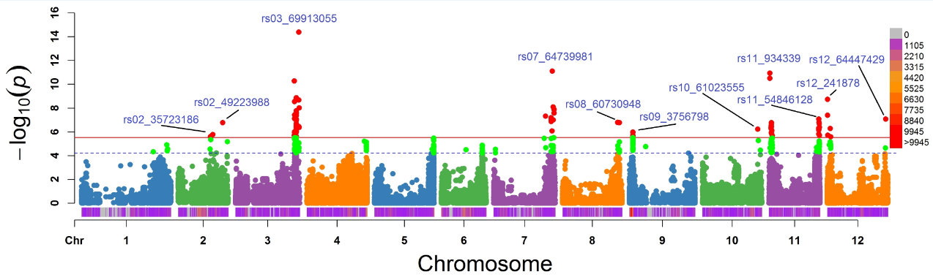

Background
Materials
Methods
Results
Challenges
Expectations
Polygenetic effects
Asparagine
galactono-1,4-lactone dehydrogenase
Serine
Threonine

Slide 39



Background
Materials
Methods
Results
Challenges
Expectations
Strong LD!!!

